Slide 1
Cultural Essentialism and CQ
Website exercise

Slide 2
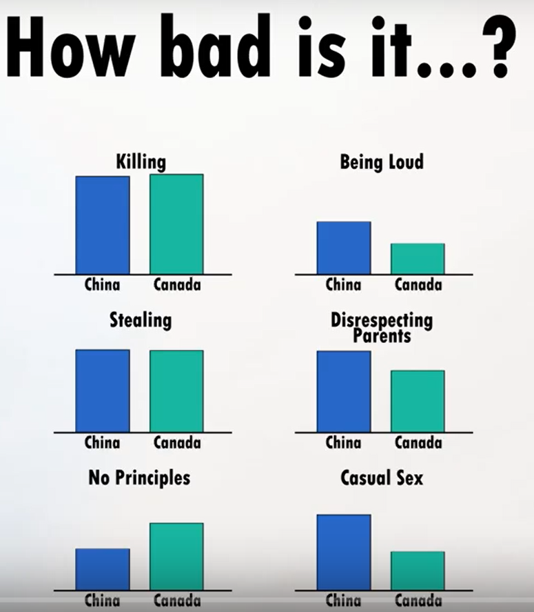
Cultural differences?
First, let’s look at these bar graphs:

Slide 3
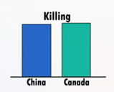
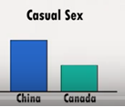
How would you describe the bar graphs in words?
“This graph shows that…”

Slide 4
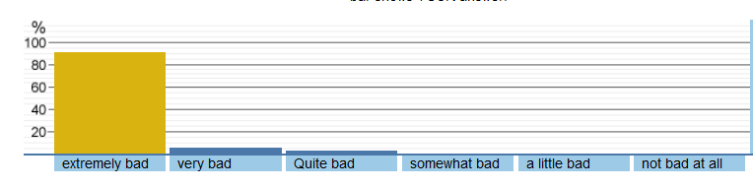
Website exercise
Thought experiment first:
  Question 1: How bad is it to kill someone?
  Cultures: 200 students each in Beijing and Vancouver.
  What do you guess the “most common” answer is for Beijing students? What about Vancouver students?
  What percentage of the students would you guess give that “most common answer?”

Slide 5
Website exercise
Thought experiment first:
  Question 2: How bad is it to have casual sex with many people?
  Cultures: 200 students each in Beijing and Vancouver.
  What do you guess the “most common” answer is for Beijing students? What about Vancouver students?
  What percentage of the students would you guess give that “most common answer?”

Slide 6
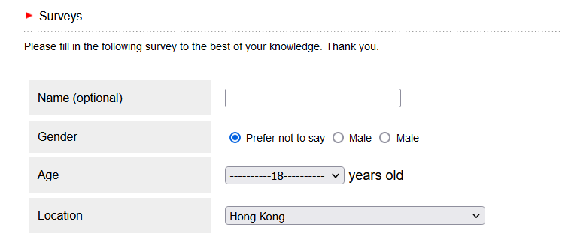
Website exercise
http://understandingdiversityeduhk.org/
  Select the English version
  Click on “How BAD is this behavior?” survey
  NO need to fill out the top section; but click your answer to the 4 questions below, and “submit.”

Slide 7
Digest
First thoughts–
  What surprised you? What didn’t surprise you?
Was there a bigger, or smaller, “cultural gap” than you expected?
  Note: This depends on the question, right? For which questions?
  The “size” of cultural differences really depends on what opinion / attitude you’re talking about.
Did you predict a higher percentage of within-culture agreement than there actually was?
  Be careful– try to avoid the “Outgroup homogeneity effect”
  Notice the within-culture variety. Is there a “typical” answer? What percentage of people actually gave that “typical” answer?
“Could you find a friend”– what is the website trying to emphasize with that question?

Slide 8
Using cultural differences wisely…
The key difficulty in talking about cultural dimensions and cultural differences:
  Yes, cultural differences exist
  But…. stereotyping, prejudice, and discrimination are bad
How can we learn one without doing the other?
1 key-- Avoiding Essentialism (about cultures):
  Definition: A sense that there is an invisible “essence” about something that makes it different from other things, and that is difficult or impossible to change

Slide 9




Essentialism: a natural instinct
What makes a tiger a tiger, and not a cat?
What if we took a tiger, and bleached his stripes?
What if a midget tiger were born?
What if we painted stripes on a cat?
…Instinctively, we still think “That’s a cat with stripes, not a tiger.”
The “essence of cat” is still there and is not changed.

Slide 10
Anti-cultural-essentialism video
https://youtu.be/RsPFyy4MptY
“How much” does one’s culture influence one’s personal opinions, values, attitudes?
“How much” can someone else’s culture predict about his/her personal opinions, values, attitudes?
What ELSE can their cultural background predict, perhaps more accurately?

Slide 11
“Good” Cultural awareness
Aware that cultural background could be affecting your and others’ behavior/thinking/expectations/perceptions
But, with a more accurate ways of thinking about culture:
  Awareness of individual differences as well as cultural differences (within-culture vs. between-culture differences)
  Awareness of different aspects of culture (sometimes cultures are similar on one aspect, different on another)
  Being aware that there can be personal and cultural change
  Being non-ethnocentric (open-minded, non-judgemental)

Slide 12
So, how to talk about cultural differences?
Try to keep within-culture individual diversity in mind; use words like:
  Chinese culture “tends to” or “emphasizes” or “encourages”
  A Chinese person “might” be “more likely to”
  I “feel pressure to”
  Chinese people might expect others to… might see that as…. We are often taught that….
Try to avoid:
  Chinese people “are XYZ”

